Slide 1



Prediction of Vessel RAOs:
Applications of Deep Learning to Assist in Design
James Frizzell │ Dr. Mirjam Furth
Texas A&M University
02/22/2022

Slide 2
Objective Overview
Develop a fast, accurate algorithm to estimate Response Amplitude Operators (RAOs)
Avoid the need for detailed Computer Aided Design (CAD) Modelling

Slide 3
Proof-of-Concept Process
Simplify vessel dataset to series of box barges
Analyze the RAOs of each vessel in ANSYS AQWA
Develop and train a Deep Neural Network (DNN) on the data

Slide 4
Data Collection
Parametric study of 214 box barges
Frequency-dependent response was evaluated in 6 degrees of freedom
Curve of the form
f(y) = Ae^{-Bt} + Cte^{-Bt}
fit to the data for each degree of freedom
Parameters A, B, and C were used as training features for the DNN
Length | 0.3 - 25 meters
Beam | 0.1 - 16 meters
Draft | 0.033 - 1.23 meters

Slide 5
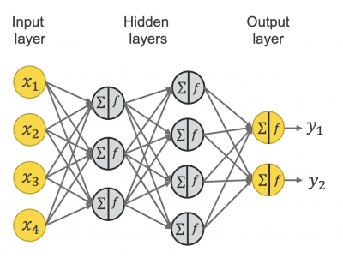
Neural Network Architecture
Multiple inputs (x1… x4) are passed into the model
Each input is passed through each node on a hidden layer
The inputs are summed together with varying weights
The resulting summation from each node is passed as an input to each of the nodes in the next hidden layer
Credit: knime.com

Slide 6
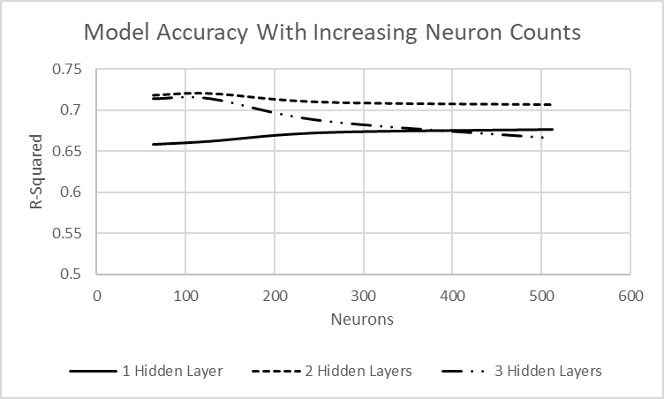
Neural Network Architecture
Use Keras and TensorFlow
4 vessel characteristics chosen as inputs
3 parameters (A, B, C) for all degrees of freedom set as outputs
Length | 0.3 - 25 meters
Beam | 0.1 - 16 meters
Draft | 0.033 - 1.23 meters
Wave Heading | 0 - 180 degrees
Input Layer | Hidden Layer 1 | Hidden Layer 2 | Output Layer
(,4) | (,256) | (,256) | (,18)

Slide 7
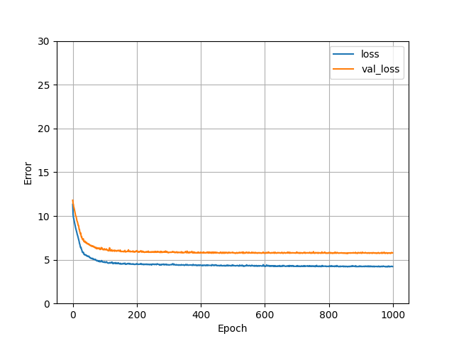
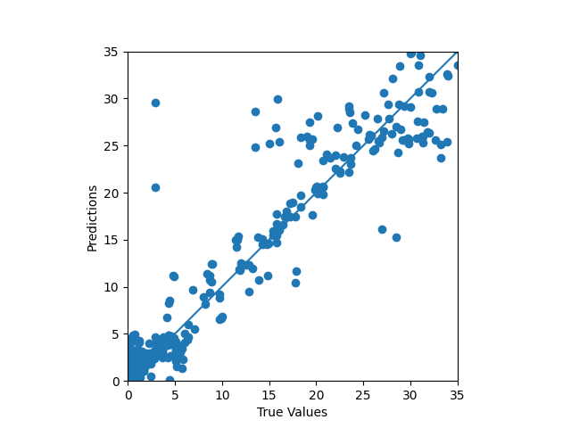
Training Results
R²=0.717

Slide 8
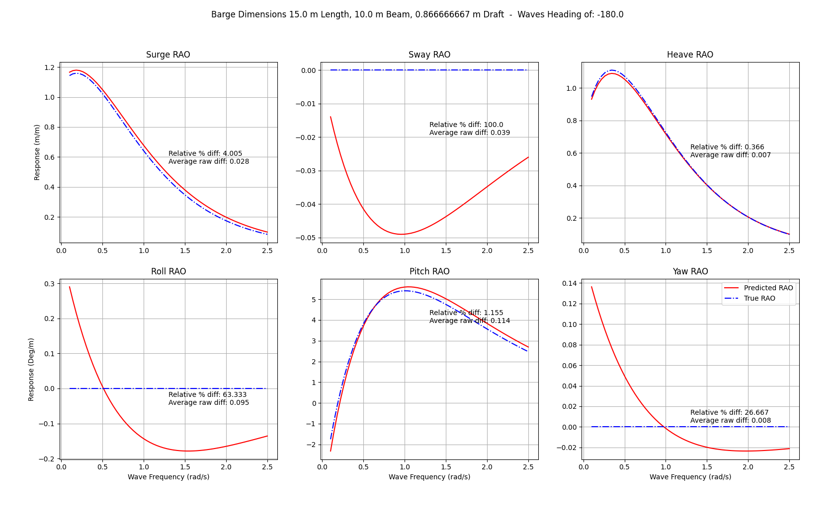
Sample Results
Barge Dimensions: 15.0 m Length, 10 m Beam, 0.867 m Draft
Wave Heading = 180° (Head seas)
Relative Percent Difference (RPD) used to avoid division by zero issues
Some RAOs have high RPD, but low raw error.
The raw error is more important in these cases

Slide 9
Outro slide
Future work
Error analysis

